Slide 1
CGAN Application for AM Data Privacy Guarantees

Slide 2
What are Conditional Generative Adversarial Networks (cGANs)?
cGANs are an updated extension of the traditional GAN model, and were discussed by Goodfellow et al [1] and first developed by Mirza et al in 2014 [2]
This updated GAN model is aimed at including conditioning information to both the generator and discriminator aid in training the model. (Generally, this is the class of image or other property)
Class labels are one hot encoded and concatenated with the input to both the generator and discriminator model
This essentially works to guide the generator to produce images with specific features
Discriminator can evaluate both real v. fake and how well the generated image features align with the expected input features.
Deep Convolutional GANS are another specific GAN Architecture that is commonly incorporated into cDCGANS. Instead of one hot encoding, these GANS use and encoder/embedding layer
This is followed by a fully connected layer of linear actuations to scale the embedding to the size of the image before concatenating the two together

Slide 3
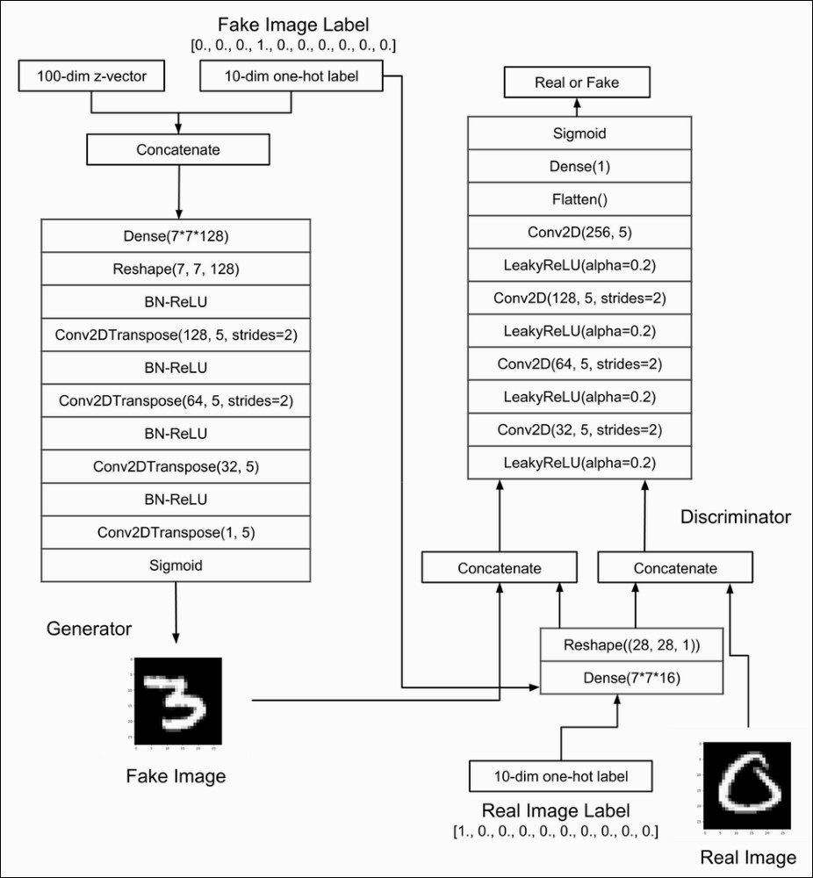
cGAN Model Flow
Original Data
X
Real Images
x|y
DISCRIMINATOR
y
Class
Labels
z|y
Latent
Space
l|y
GENERATOR
Fake Images

Slide 4
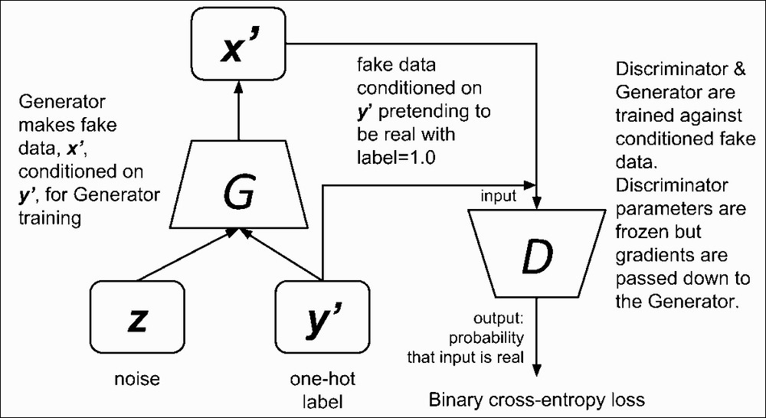

Slide 5
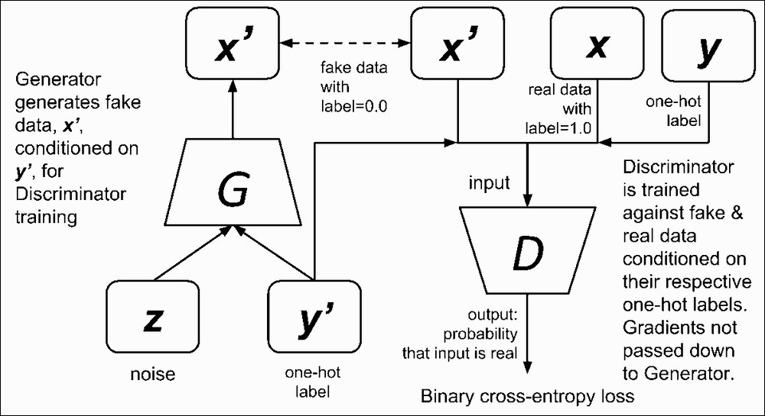

Slide 6
Advantages Over Traditional GANs
cGANs have TWO main advantages over traditional GANs
Improve the overall GAN model
Targeted Image Generation
To start, by incorporating this additional information, cGAN provide several improvements:
More Stable Training
Faster Training and Convergence
Higher Quality Images
In addition, these class labels allow for targeted image generation, given a specific conditioning value, which is extremely useful in a variety of applications
Image to Image Translation
Targeted Image generation
Video Generation
Unbalanced Data Generation (If enough samples to learn distribution)

Slide 7
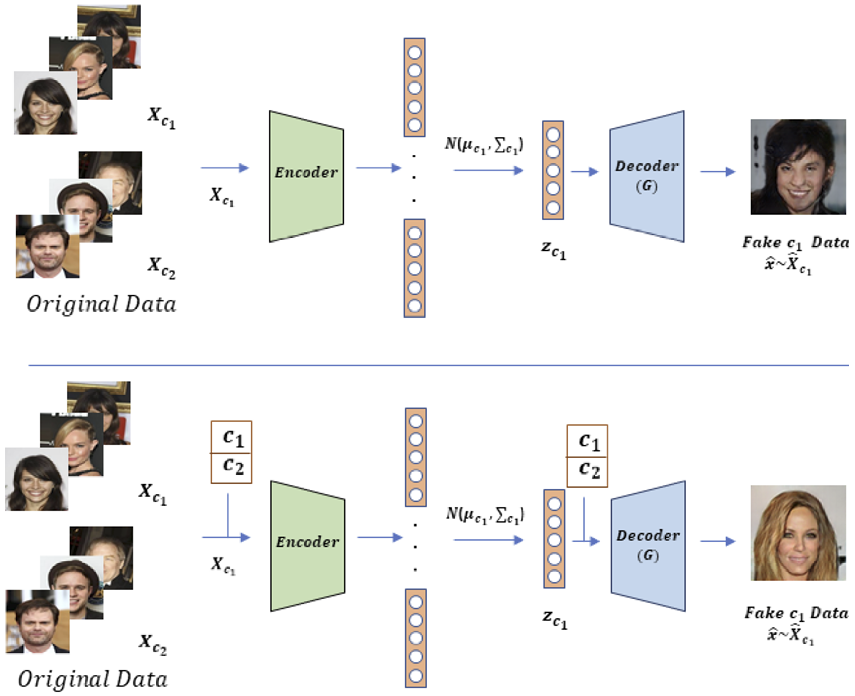
Ghosting
Distortion
Noise
*Genderless
GAN
Higher Quality
Specific Gender (c)
cDCGAN

Slide 8
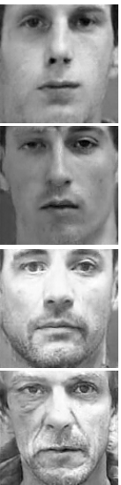
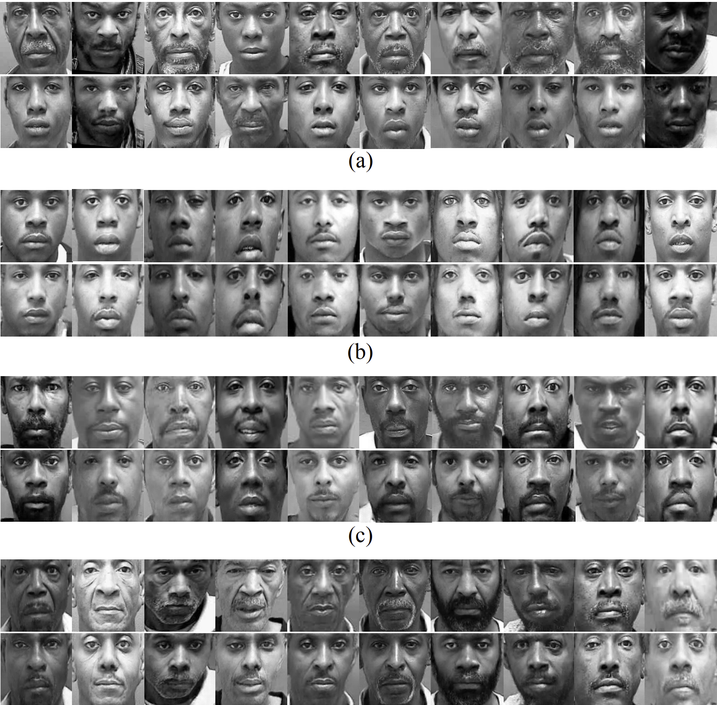
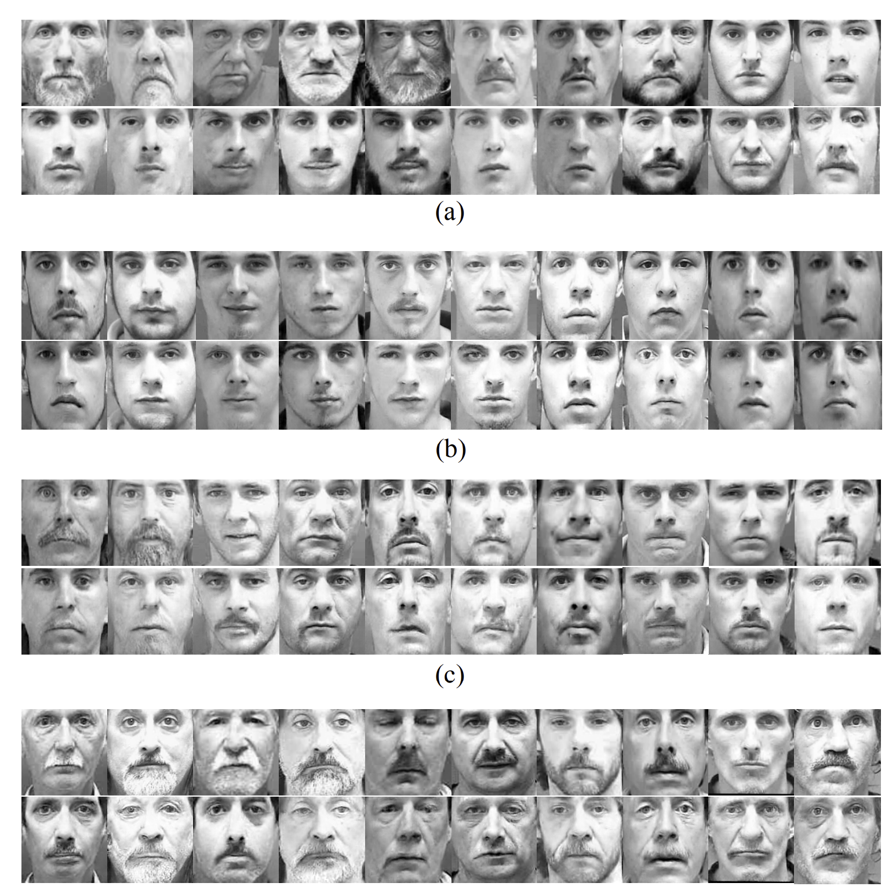
GANs and cGANs for Guaranteed Privacy Protection
cGAN image generation for AM Thermal Processed, combined with existing ADDAM research can further develop effective anonymization techniques.
GANs are routinely used for synthetic image generation, which has a large overlap with data privacy research. Some examples:
1. Synthetic Medical Image Generation [3]
2. Synthetic Face Generation [4],[5]
3. Synthetic Tabular Data [6]
Generates Synthetic Images to replace original Images
Original Image Distribution
This method of data privacy with GANs is not an optimal method to apply to AM Process Data Anonymization
GAN Model
+
Physical Feature
Condition
(Gender, Age, Race, Facial Hair, Glasses, etc.)

Slide 9
cGANs in AM
Until recently, GANs have not been extensively used for AM application. A couple important publication to note are [7] and [8]
The first [7] aims to use cGANs to predict and emulate thermal signatures for Laser Metal Deposition. The Generated images are conditioned based on the layer of the melt pool. This enables the ability o have some early prediction of the later layer thermal signatures in the earlier layers.
The second [8] aims to improve the contrast ratio of thermal images for image segmentation purposes. Essentially, leveraging the GAN model to aid in the reconstruction of the melt pool to develop more accurate segmentation maps.

Slide 10
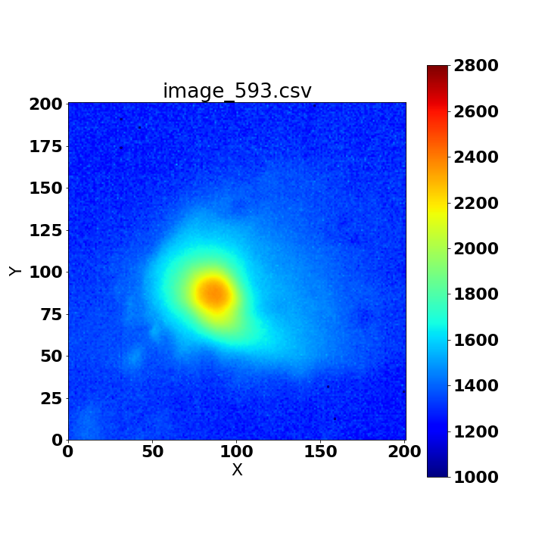
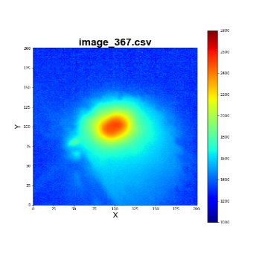
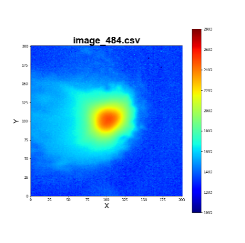
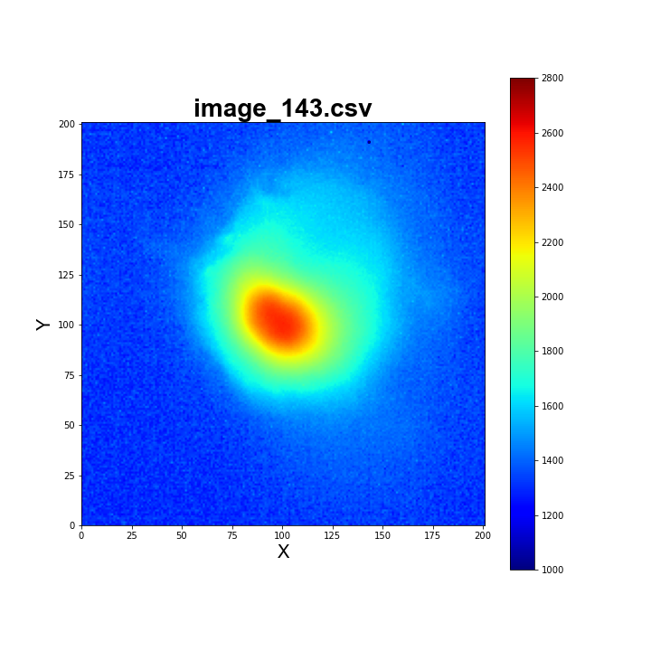
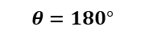
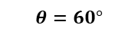
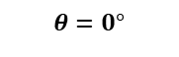
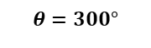
Current Research Direction
AM Process Thermal Data is extremely information-rich for features that can be used for anomaly detection
This AM Process data can be shared externally for a variety of uses, including:
Transfer Learning for Anomaly Detection/in-situ monitoring mode development
Manufacturing as a Service (MaaS)
However, these extremely useful features are embedded within features that can be leveraged to malicious gain insight into design-related information (Such as Printing Direction Below)
$$θ=0°$$
$$θ=60°$$
$$θ=180°$$
$$θ=300°$$

Slide 11
Identified Research Gaps
Privacy Gain 25-30%
Two Major Gaps:
Anonymization is balancing Utility Loss with Privacy Gain, using a novel adaptive deidentification technique
Not anonymizing every single image, applying less anonymization to anomalies to preserve their utility preservation.
2. Lack of Diverse Identities within Dataset
Only 2-3 Infill patterns for testing, not enough diversity
Traditional Anonymization sets have only unique reference values for anonymization.
Cyclic or Repeating patterns within the AM Printing Process + limited identities provides ample opportunities to re-identify the general printing pattern of the data set
Layer n
.
.
.
Layer 3
Layer 2
Layer 1

Slide 12
Proposed Research with cGANs
The main objective for this proposed research is to leverage cGANs to generate synthetic melt pool images, conditioned on a print direction orientation.
This will allow for the increased data privacy, by expanding the protection from melt pool wise de-identification to Layerwise de-identification.
Adding synthetically generated images of random orientation to synthetically create randomized infill patterns
This affect compounds through each layer, as the previous patterns and connections between layers are now severed as the same layer-wise infill pattern will not repeat
This will further protect the confidential design features from malicious third part re-identification attacks
Layer n
Layer n
after Anonymization

Slide 13
Challenges with leveraging cGANs
Perimeter orientations can give away more of the confidential design and geometric information than the infill print orientations (however both are important)
It is difficult to evaluate the perimeter melt pools:
Hard to determine and label angle orientations
Extremely limited Data (5-6 images per layer)
In addition, Generating Synthetic Images and Adapting them into the original Data set will present more challenges:
Creating High Quality Images that are indistinguishable from original image distribution
Maintaining the Time/Spacial correlation of the images (maintain general structure for anomaly detection) Adding images at complete random can disturb and disrupt this connection

Slide 14
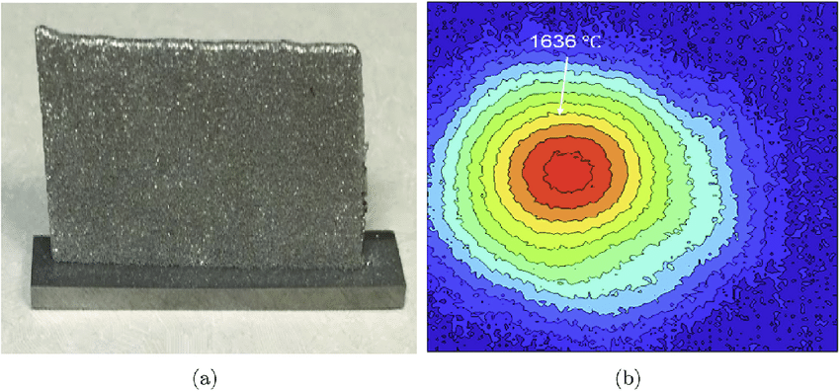

Proposed Design of Experiment
Print multiple artifacts with controlled/diverse angular orientations (based on thin wall artifacts)
This will allow for
Better control over print orientations
Better control to simulate data that represents the perimeter
90
Angular Orientations
$$θ°$$
0
180
Thin Wall A
Thin Wall Example
270
Thin Wall B

Slide 15
Proposed Evaluation Procedures
This is another roadblock for this research objective…
The discriminator works to train the GAN to generate better and better images, however there are other metrics used to evaluate the overall performance of the GAN:
Inception Score
Fréchet Inception Score
Potentially not effective for use on AM data, as they are pretrained, external models using data that is not representative of AM data
Solutions:
First, evaluate GAN performance on the AM data, as well as the IS/FID scores and how well they can reflect the data
From there, potentially updating or developing an extension of the FID framework:
[9] Compound Fréchet Inception Distance
[10] Huasdorff Metric

Slide 16
References
Mirza, M., & Osindero, S. (2014). Conditional Generative Adversarial Nets. http://arxiv.org/abs/1411.1784
Goodfellow, I. J., Pouget-Abadie, J., Mirza, M., Xu, B., Warde-Farley, D., Ozair, S., Courville, A., & Bengio, Y. (n.d.). Generative Adversarial Nets. http://www.github.com/goodfeli/adversarial
Middel, Luise, Christoph Palm, and Marius Erdt. "Synthesis of medical images using gans." Uncertainty for Safe Utilization of Machine Learning in Medical Imaging and Clinical Image-Based Procedures. Springer, Cham, 2019. 125-134.
Abramian, David, and Anders Eklund. "Refacing: reconstructing anonymized facial features using GANs." 2019 IEEE 16th International Symposium on Biomedical Imaging (ISBI 2019). IEEE, 2019.
Wu, Y., Yang, F., Xu, Y., & Ling, H. (2019). Privacy-Protective-GAN for Privacy Preserving Face De-Identification. Journal of Computer Science and Technology, 34(1), 47–60. https://doi.org/10.1007/s11390-019-1898-8
Coutinho-Almeida, João, Pedro Pereira Rodrigues, and Ricardo João Cruz-Correia. "GANs for Tabular Healthcare Data Generation: A Review on Utility and Privacy." International Conference on Discovery Science. Springer, Cham, 2021.
Guo, S., Guo, W., Bian, L., & Guo, Y. B. (2022). A Deep-Learning-Based Surrogate Model for Thermal Signature Prediction in Laser Metal Deposition. IEEE Transactions on Automation Science and Engineering, 1–13. https://doi.org/10.1109/TASE.2022.3158204
Liu, Weibo, et al. "Melt pool segmentation for additive manufacturing: A generative adversarial network approach." Computers & Electrical Engineering 92 (2021): 107183.
Wu, Y., Yang, F., & Ling, H. (2018). Privacy-Protective-GAN for Face De-identification. http://arxiv.org/abs/1806.08906
W. Li, Z. Liang, P. Ma, R. Wang, X. Cui and P. Chen, "Hausdorff GAN: Improving GAN Generation Quality With Hausdorff Metric," in IEEE Transactions on Cybernetics, doi: 10.1109/TCYB.2021.3062396.

